Slide 1
Areas of further study

Slide 2
Topics
Responsive Web Design (RWD)
Javascript, Jquery
Content Management Systems
Keeping up with the industry

Slide 3
Responsive Web Design

Slide 4
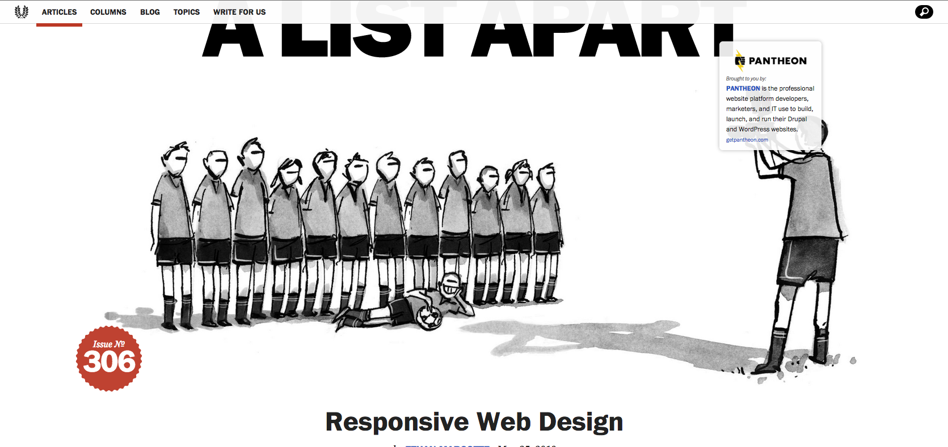
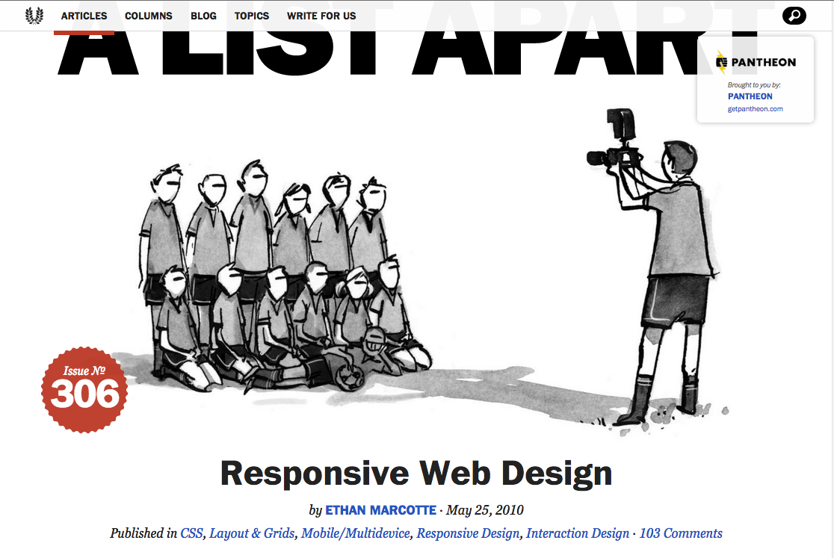

Slide 5
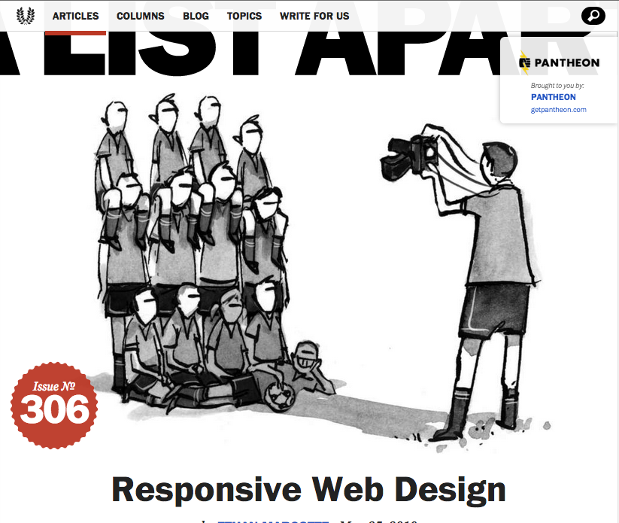
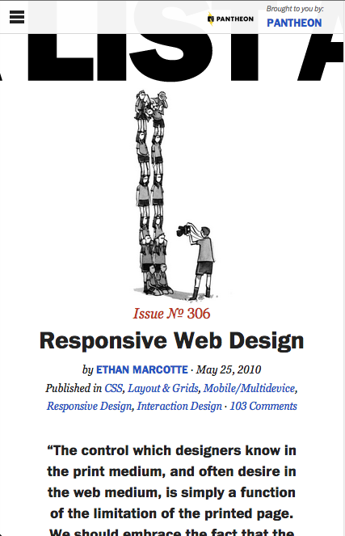

Slide 6
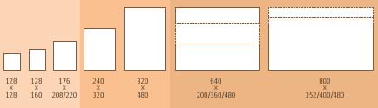
Change CSS based on screen size
mbricks
http://sender11.typepad.com/sender11/2008/04/mobile-screen-s.html

Slide 7
CSS media query
@media (max-width: 400px) {
h2 { }
}

Slide 8
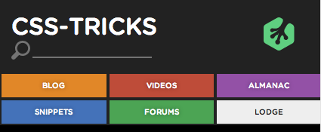
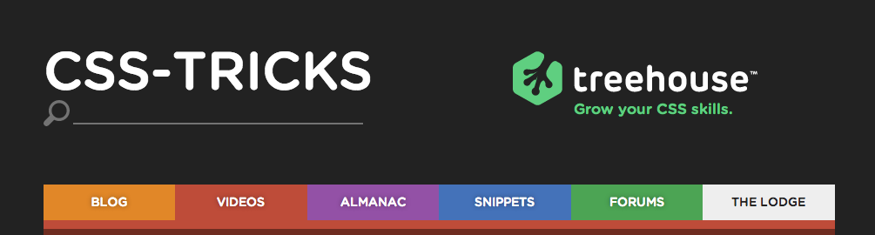
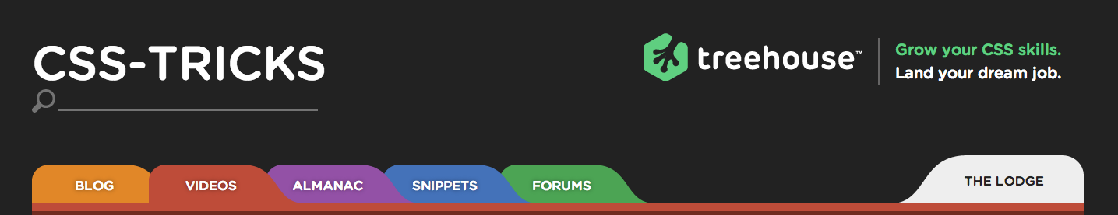

Slide 9
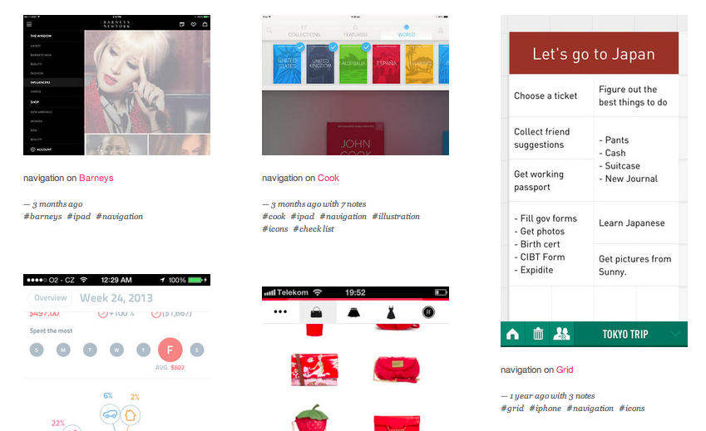
Look at what’s out there now
Lovely ui
Notes:
http://www.lovelyui.com/

Slide 10
Javascript

Slide 11
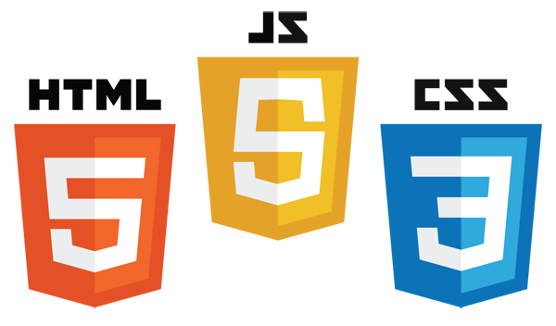
Content
Interaction
Style

Slide 12
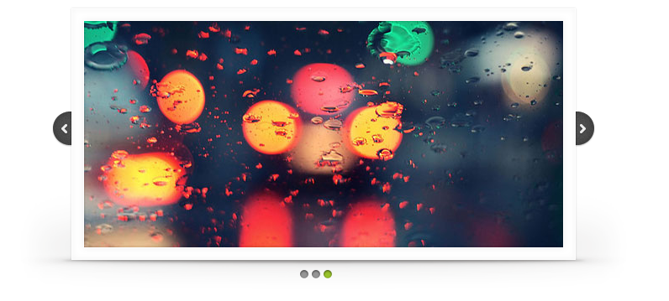
Slides.js
Notes:
Slideshows

Slide 13
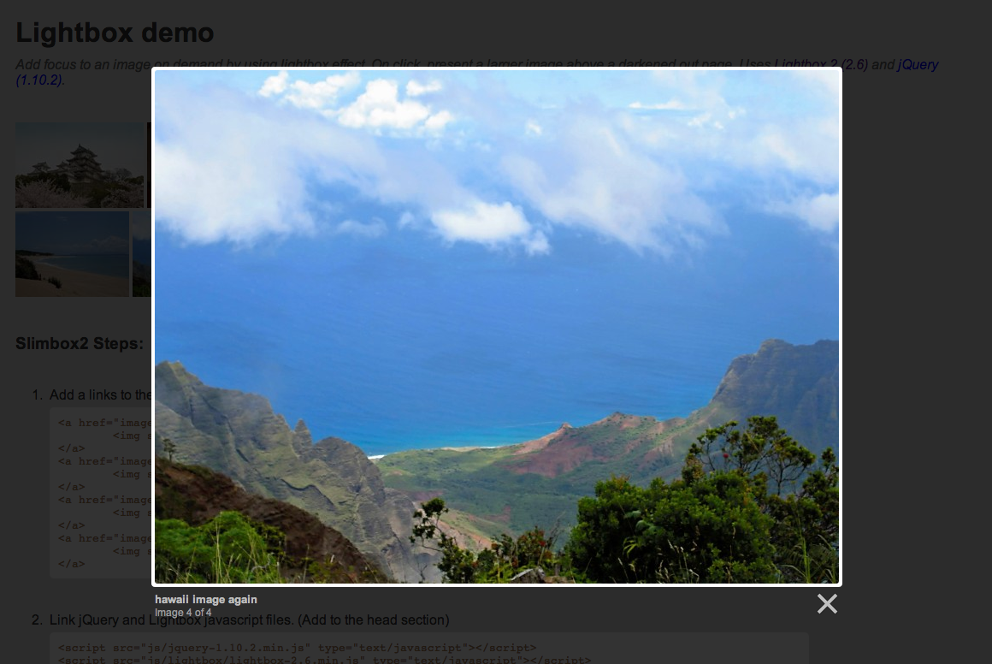
Slimbox2
Notes:
Lightboxes

Slide 14
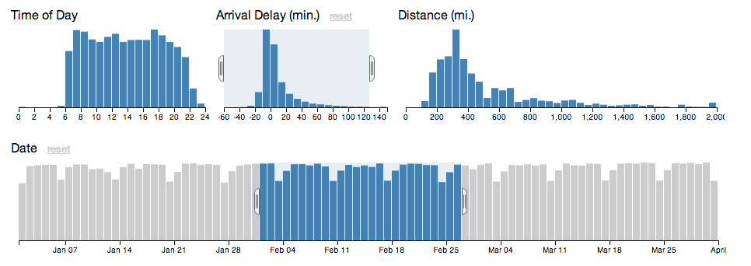
D3.js - Crossfilter
Notes:
http://square.github.io/crossfilter/

Slide 15
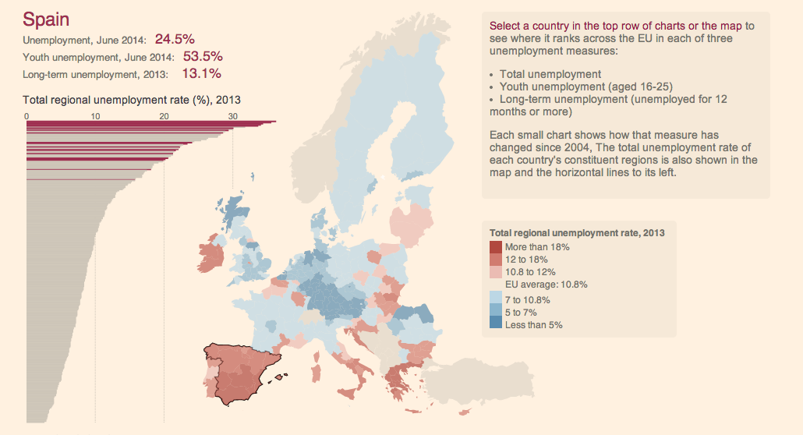
EU Unemployment tracker - Financial times
Notes:
http://blogs.ft.com/ftdata/2014/07/31/eu-unemployment-tracker/

Slide 16


Learn on your own!

Slide 17
Content Management Systems (CMS)

Slide 18
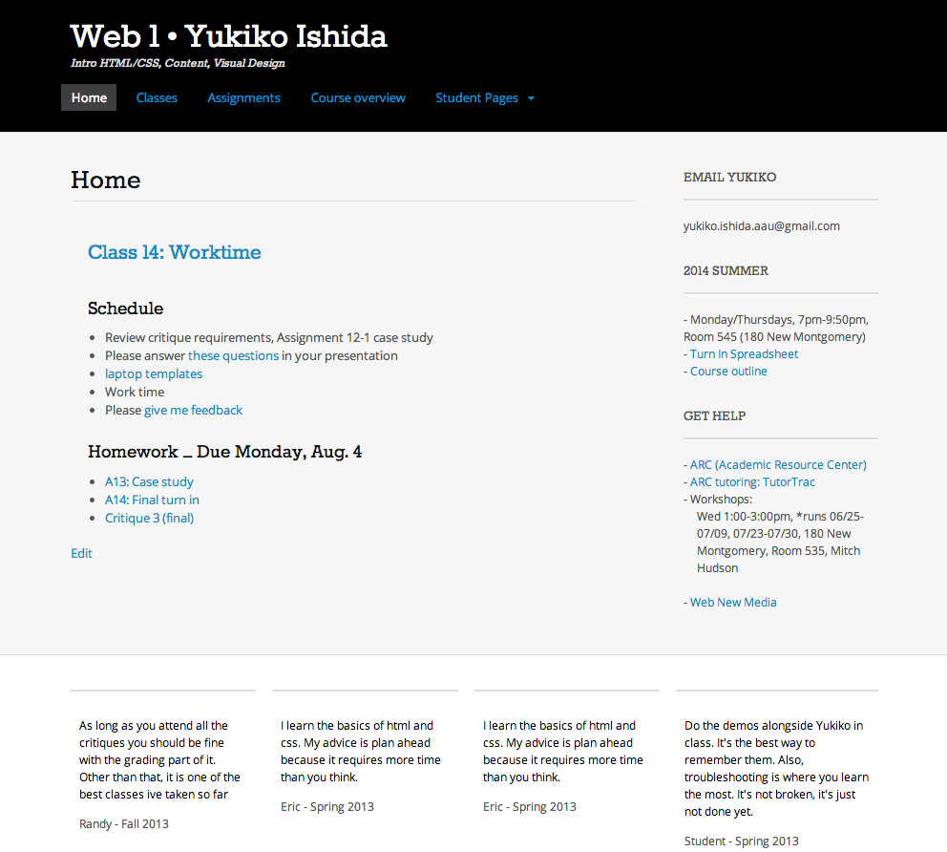
Header
Post
Sidebar
Footer
Notes:
A Content management system is a tool that helps you manage content by splitting up your site into templates…

Slide 19
Post
Notes:
And let you focus on creating/writing the actual content

Slide 20

Nice interface
Flexible, plugins & themes
You host it
Customize in HTML/CSS

Slide 21
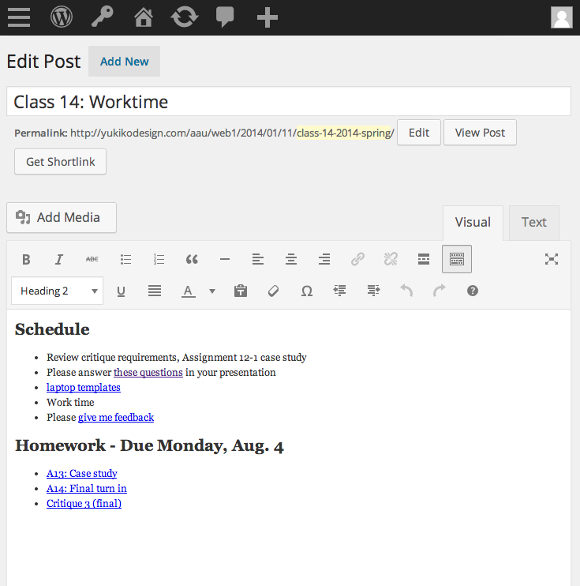
Notes:
Nice interface for writing – Clean, focus on design

Slide 22
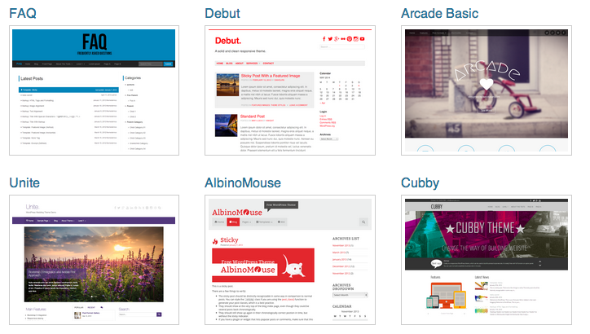
Notes:
Lots of plugins and templates to start from

Slide 23
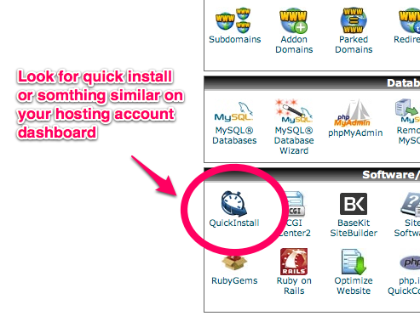
Notes:
Easy to install, usually listed in your hosting admin dashboard

Slide 24
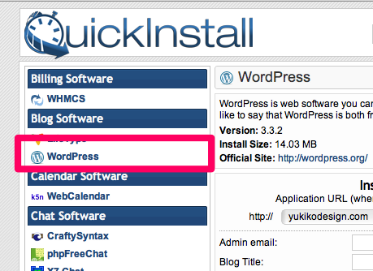
Notes:
Just find it in the list of other CMS’

Slide 25
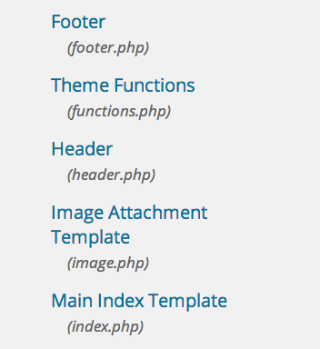
Notes:
Customizing your templates is pretty straightforward. Different sections split into .php files

Slide 26
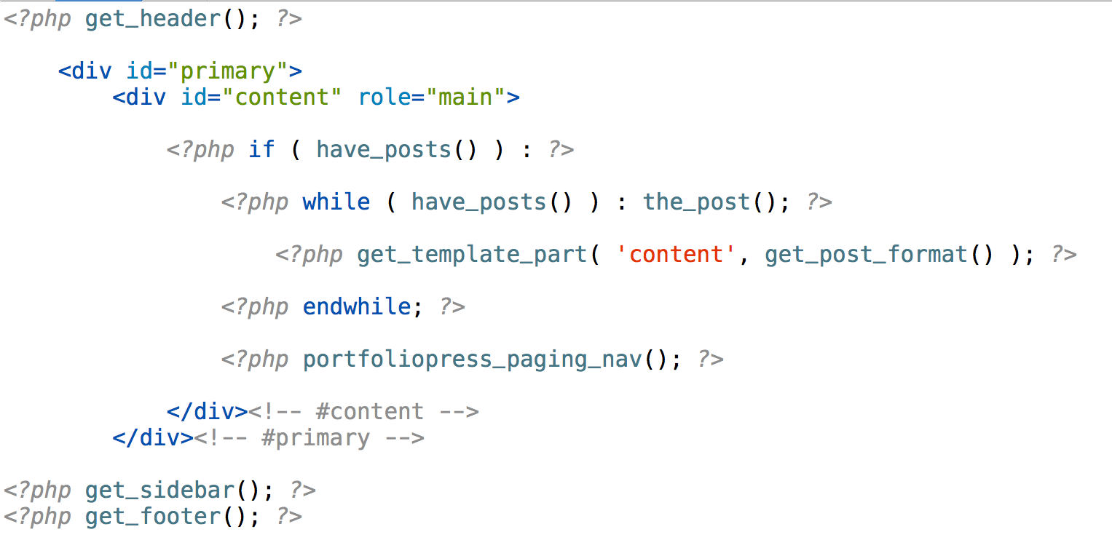
A Wordpress template
Notes:
Which get pulled into a template which looks a lot like html except for where it pulls in the header, footer

Slide 27
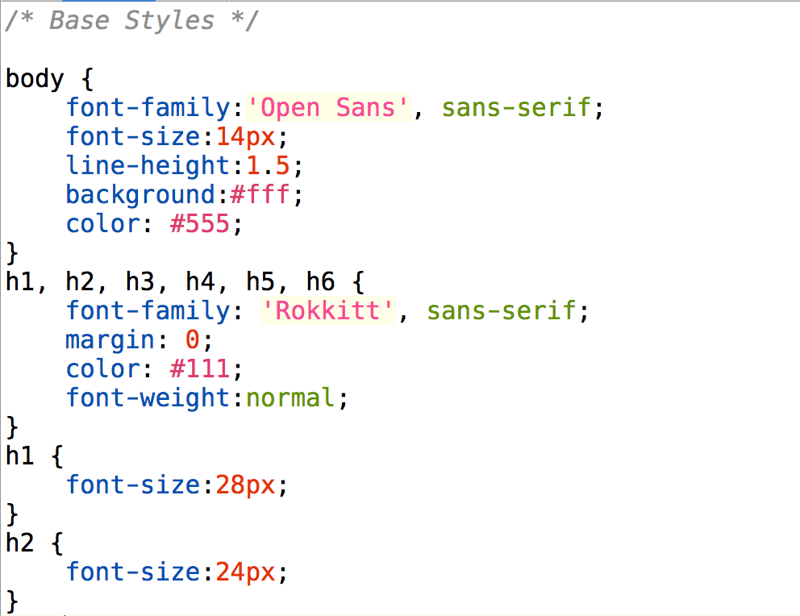
Notes:
And then the styles are still css

Slide 28
Keeping up to date

Slide 29
Go out and read!
Notes:
Best way of learning is to read and look up.

Slide 30






